Slide 1

PAINT INDUSTRY

Slide 2

INTRODUCTION
The Indian paint industry has been growing at a rate of near about 15% for the past few years.
The industry is estimated around Rs.21000Cr.
The per capita consumption India is 1.5kgs per annum as compared to the golbal average of 15 kgs per annum.

Slide 3

HISTORY OF PAINTS
The Indian paint industry was initiated in 1902, when Shalimar paints set up its first factory in kolkata.
After liberalization, as the excise duties got drastically reduced from 40% to 16%, the industry recorded a healthy growth of 12-13% annually.

Slide 4
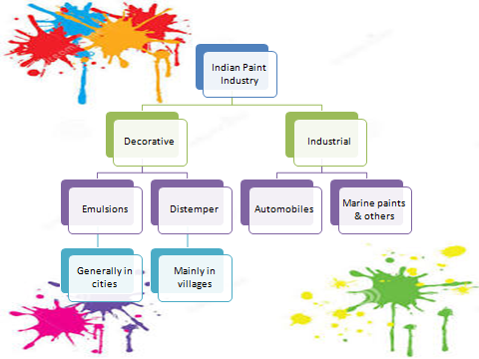

Slide 5

NEW CONCEPTS OF PAINTING
Multi colored room concept
Lead free colour

Slide 6

PRODUCTION
PROCESS
STEP 1: MEASURING AND MIXING
(Raw Materials)
STEP 2: MILLING

Slide 7
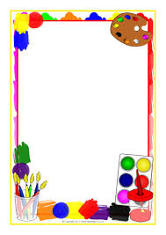
STEP 3: BLENDING AND FILTERING
(Blended and tonned paint is filtrated)
STEP 4: PACKAGING AND EXPORTING
(Reaching it to the end customers)

Slide 8

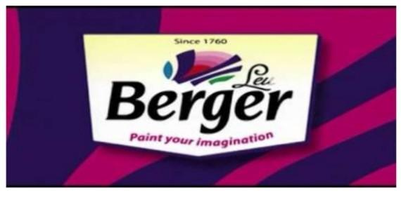
BERGER PAINTS

Slide 9
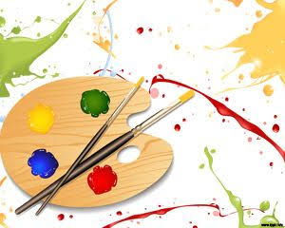
Berger paint India ltd is a Indian based company its headquaters is in kolkata
and it was founded in 17 th december 1923

Slide 10

KEY PERSONS
KULDIP SINGHDHINGRA(CHAIRMAN)
GURBACHAN SINGH DHINGRA (VICE CHAIRMAN)
ABHIJIT ROY (CEO)

Slide 11

PRODUCTS
1.Paints
2.Coating
3.Construction
4.Chemicals

Slide 12

Revenue:4634 CRORE
Operating Income:655 CRORE
Net Income:369 CRORE
No.Of.Employees:2800+
Tagline:NO DAGG NO DHAABA
Website:WWW.BERGERPAINT.COM
Share Price:NSE:254.44 INR

Slide 13

VISION
To be the most admired Indian paint and coating solutions company with globaly recognised competencies

Slide 14

MISSION
To maximize share holders value by developing and delivering innovative and best solutions for our customers,consistently outperforming our personsand providing a dynamic and challenging work environment for our emplyees

Slide 15

MAJOR COMPETETORS
1.ASIAN PAINT
2.NEROLAC
3.AKZO NOBEL
4.SHALIMAR

Slide 16
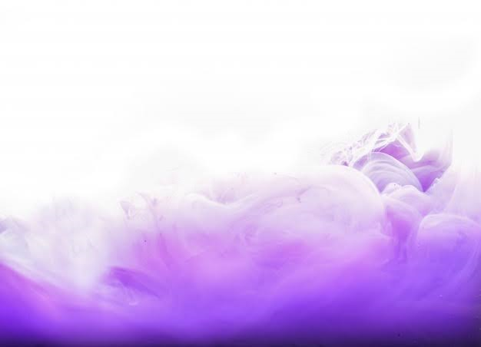
PHILOSOPHY
1.Innovation and change
2.Goals and perform at high level
3.Performance,customer first,valuing people
4.Managing and mission stake holders

Slide 17

QUALITY POLICY
1.Provide full satisfaction to the customers
2.Creating an environment which encourages team effort
3.International standards

Slide 18

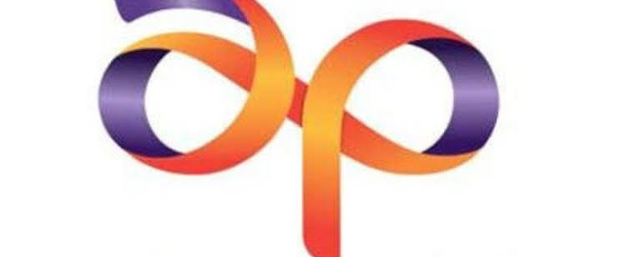
ASIAN PAINTS LTD. (ASIANPAINT)

Slide 19
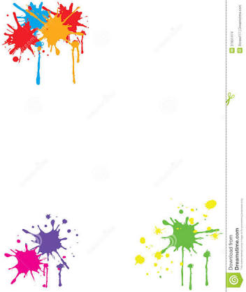
Asian Paints manufactures a wide range of paints for decorative and industrial use.
The products of the company include ancilliaries automotive decorative paints and industrial paints.
In Decorative paints the company is present in all the four segments namely Interior Wall Finish, Exterior Wall Finishes, Enamels and Wood Finishes.
They have also introduced many innovative concepts in the Indian paint industry like Colour Worlds, Home Solutions, Kids World and Royale play Design.
Asian Paints Ltd was founded in 1942 and incorporated in the year 1945.
In the year 1965 the name of the company was changed to Asian Paints Pvt Ltd.
In the year 1973 the company was converted into a public limited company.

Slide 20

FOUNDERS
ChampaklalChoksey, ChimanlalChoksi, Suryakant Dani and Arvind Vakil.

Slide 21
VISION
Asian Paints’ vision is to be a world-class, Research & Technology led organisation. Driven by innovation, Asian Paints is agile and responsive to changing customer and market needs, as well as evolving technology. Through R & T, we will align ourselves with future customer needs and drive expansion. Continuous R & T will enable us to grow bigger in size and better in quality.

Slide 22
MISSION
The mission statement read‘To provide paints as per market demand, ensuringdesired level and quality of customer service. Asian paints aims to become the largest decorative paint company in the world and to rank among the top five paint manufacturing companies of the world.

Slide 23

PRODUCTS
Interior walls
Plain finishes
Wall Coverings
Kid’s World
Stencils
Undercoats
Exterior walls Plain Finishes Textures
Wall Art
Tile Guard Undercoats Waterproofing

Slide 24

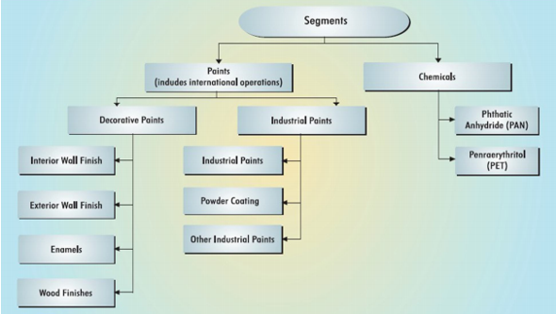
MAJOR BRANDS
The five corporate brands as per the regional operation are viz. Asian Paints, Berger International, SCIB Paints, Apco Coatings and Taubmans.
Brands within Asian Paints are: Ace & Apex, Apcolite, Apex, Apex Ultima, Asian Paints,Colour Next, Premium Gloss Enamel, Royale, Royale Play, Touchwood, Tractor Emulsion, Utsav.

Slide 25

The five corporate brands as per the regional operation are viz. Asian Paints, Berger International, SCIB Paints, Apco Coatings and Taubmans.
Brands within Asian Paints are: Ace & Apex, Apcolite, Apex, Apex Ultima, Asian Paints,Colour Next, Premium Gloss Enamel, Royale, Royale Play, Touchwood, Tractor Emulsion, Utsav.

Slide 26
Major Competitors for Asian Paints
Asian paints is the leader keeping the other competitors far behind. In terms of gross sales we can rank the competitors of Asian paints as :
1.Nerolac paints
2.Berger Paints
3.ICI Paints.

Slide 27

TRACTOR EMULSION
Tractor Emulsion Advanced comes with Superior Anti Fungal Shield and gives a smooth finish to the wall.
It is a smart choice if you have been previously using distemper.
A SMART UPGRADE
Offers the finish of plastic paint, at a cost that is not too different from distemper. It gives higher coverage than distempers and lasts for 3-4 years.
anti fungal shield.
Excellent protection against fungal growth thus reducing the chances of fungal black spots on your wall

Slide 28

COLOUR
Wide range of more than 1600 shades to choose from.
Specification:
DRYING TIME: Surface dry time 30 min
Stability of thinned paint to be used within 24hrs.

Slide 29

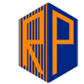
Ruby Paints Private Limited

Slide 30

Founded in the year 1992 under companies act as a private limited company located in Chennai
Ruby Paints Private Limited is a Private incorporated on 08 December 1992.
It is classified as Non-govtcompany and is registered at Registrar of Companies, Chennai.

Slide 31

Directors of Ruby Paints Private Limited are Palanipalam, BalasubramanianVairasamy Pandian and Natarajan Vairavasamy Pandian.

Slide 32


Slide 33

Team
TEAM
RUBY PAINTS have a team of efficient professionals is dedicated and committed towards achieving the goals of organization.
Members of our team are well-versed with the latest trends that prevail in the international market and formulate each product in accordance with the same.
RUBY PAINT professionals have helped in directly communicating with the customer to understand their exact requirements.
This allows to meet with the demands of clients by catering different requirements of the national as well as international markets.
workforce consists of the following members:
Chemical engineers
Quality analysts
Procuring agents
Store keepers
Packaging experts
Office administrators
Skilled labor
Annual Turnover OF THE RUBY PAINT: | Rs. 25 - 50 Crore

Slide 34
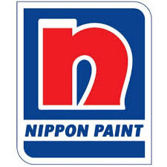
NIPPON PAINTS

Slide 35
Nippon Paint was established in Tokyo by Mr. Moteki Jujiro in march 14 1881 and is now the largest coatings manufacturer in Asia. The company pioneered the first paint plant in Japan. After more than 50 years of growth, NIPSEA Group has established over 61 manufacturing facilities and operations across Asia Pacific region. It is the seventh largest paint manufacturer globally based on revenue.

Slide 36
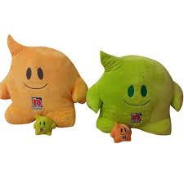
MISSION
The leading brand bringing colors & & joy to everyday life through innovative coating solutions
VISION
To be the industry leader driven by passionate people using our strong business foundations to create value & inspire all stakeholders

Slide 37
SHAREHOLDERS NAME EQUITIES %
Holdings Ltd. 126,906,000 39.0% Mitsubishi 10,939,000 3.36% Nippon Life Insurance Co. 10,817,000 3.32% Sumitomo Life Insurance Co. 10,750,000 3.30% Sumitomo Mitsui 9,999,000 3.07% Sumitomo Mitsui Trust 7,053,000 2.17% Toyota Motor Corp. 5,109,552 1.57% Nippon Paint Holdings Co., Ltd. 4,618,500 1.42% Nagase & Co., Ltd. 3,988,478 1.23%
DIC Trust 3,463,338 1.06%

Slide 38
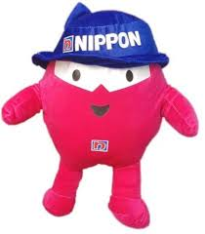
QUALITY POLICY
We are committed to providing the best quality products to our customers. We achieve this by using world-class manufacturing practices, by continually improving the effectiveness of the quality management system, by understanding customer requirements customer satisfaction and utilizing Total Employee Involvement in achieving quality objectives. Our expertise and products make us one of the most desirable paint manufacturers in India.

Slide 39

SALES TURNOVER
the company has a three% market in South India and plans to increase it to 12% by 2020 While at all India level its market share is around 1.8% and planning to increase it to four%. According to him the paint industry is estimated to be around Rs 32,000 crore and growing at around 6- 7%.
MARKETING STRATEGY
Marketing managers are responsible for developing, implementing and executing strategic marketing plans for an entire organization in order to attract potential customers and retain existing ones.

Slide 40

A W A R D S & C E R T I F I C A T I O N S
ESCO Project Awards 2012 Nippon Paint Thailand Won “ESCO Project Awards 2012” as an enterprise successful in using ESCO system by using Technology to help conserve energy. (2012) Most Trusted Brand Award – Gold Nippon Paint Hong Kong achieved Reader’s digest Most Trusted Brand Award – Gold. (2012) Asia Pacific Green Excellence Award NIPSEA Group achieved Frost & Sullivan Asia Pacific Green Excellence Award for Product Innovation in Decorative Coating. (2011) Archidex Green New Product Award Nippon Paint Malaysia awarded Archidex Green New Product Award and HomeDec New Product Award for the Nippon Paint Hydro Series. (2011)

Slide 41

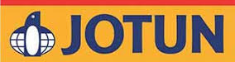
JOTUN PAINT
Jotun Group is a Norwegian chemicals company dealing mainly in decorative paints and performance coatings (marine, protective and powder coatings). As of February 2017, the company has a presence in more than 100 countries around the world, with 9500 employees, 63 companies in 45 countries, and 37 production facilities in 21 countries.

Slide 42
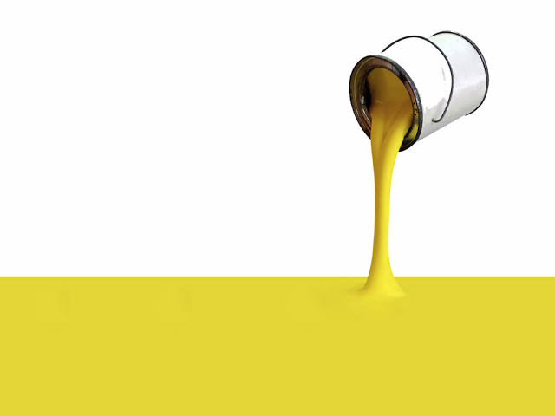
VISION
To instill a brand power of Jotun Paints as a preferred product to all valued customers
MISSION
To be a market leader as a distributor and applicator respectively for Marine & Protective Coatings and Decorative Paints to meet 100% customer satisfaction Strategy To be a market leader.

Slide 43
STRATEGIES
• To increase 5% of market share per annum
• To monitor and keep sales expectation up to date
• To enhance a brand power by providing better quality product and services at competitive price To achieve customer satisfaction, our strategies are:
• Provide customised services to meet custo omer’s need and budget
• Response to customer’s inquiry within a reasonable time frame
• Think of customer’s point of view and act on their best interests To achieve profit expectation, our strategies are:
To increase 10% of sales per annum
2. To reduce unnecessary expenditure Innovation & Development We are continuously working on

Slide 44

INNOVATIVE PRODUCTS AND SOLUTIONS
The reason for building the new Research and development center in India, is that we see India as a massive potential and we want to be close to the market. Developing the products in the market.

Slide 45

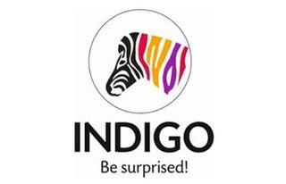
INDIGO PAINTS
Indigo paints is an Indian paint company which has its headquarters in Pune,Maharastra.
The company was founded in the year of 2000 by HemantJalan(Managing Director)
Indigo paints started manufacturing paints in Jharkhand in April 2000.
In 2001, the company expanded its product portfolio to include a range of decorative paints
In 2005, it introduced a range of speciality paint products not manufactured by any other paint company in India.

Slide 46

VISION
Brand Indigo stands for unexpected solutions to painting needs
A zebra with multi-coloured stripes, instead of just black and white indicates the unexpected nature of the brand’s solutions.

Slide 47

MANUFACTURING UNITS
Indigo paints has three manufacturing units such as
Boranada industrial area, Jodhpur (Rajasthan)
Kalamassery industrial area, Cochin(Kerala)
SIPCOT Industrial area, Pudukottai(Tamil Nadu)
MARKETING AND ADVERTISING
In 2018, indigo paints appointed Indian cricketer MS Dhoni as their Brand Ambassador
Indigo’s products have been promoted by series of TV commercials starred by MS Dhoni and mascot Zebro, conceptualized by chlorophyll brand and communications consultancy.
Zebro is a colourful striped zebra and it is the animated avatar of the indigo’s brand identity.
Zebro communicates the brand’s abilitiy to come up with surprising solutions.
In 2018, indigo paints became the title sponsor for the U Mumba team of the Pro Kabaddi League.

Slide 48
RAW MATERIALS
Most of the raw materials used in paints are petroleum based
Major raw materials are pigments (titanium dioxide, zinc oxide), solvents (mineral turpentine),resins and additives.
CAREER
Sales and marketing
Production & QC
Accounts
Laboratory and Product Development
SALES TURNOVER
The company has been growing at a CAGR(Compound Annual Growth Rate) of over 40% since 2008.
It closed the FY 2017-18 at INR 450 crores in sales.
The sales for FY 2018-19 closed at INR 596 crores.

Slide 49

THEIR UNIQUE PRODUCTS
They introduced a speciality range of products which is not manufactured by other paint industries. Some of them are as follows
India’s first metallic paint
Floor coat paint
Tile coat paint for roofs – gives an glossy look
Unique ceiling coat paint

Slide 50

SHALIMAR
Shalimar paints was founded in 1902 by A N Turner and A C Wright
Its headquarters was located in Gurgaon, India.
Shalimar paints is a pioneer in the indian paints industry with a brand legacy of 116 years
It focuses on both decorative and industrial segment in the paints business

Slide 51
MANUFACTURING UNITS
Chennai
Sikandrabad
Nashik
MARKETING STRATEGY
Advertisement
Hoarding boards
Radio
Magazines
Social media
Events

Slide 52
KAHAANI PROJECT
In this project volunteers from 7 countries painted over 8000 sq.ft which empowered 300+livelihood
RANG BADLAVKE PROJECT
In this project 1600 volunteers were involved and painted around 3000 walls for around 2weeks

Slide 53
SALES TURNOVER
The company has reported a consolidated sales of Rs 85.06 crore for 30.6.19 which was down -4.97% from the last quarter sales of 89.51 crores
RAW MATERIALS
Solvents and oils
Acids and chemicals
Others
Pigments

Slide 54

CAREER
Interior designer
Account assistant
Operations manager
Project associate
THEIR UNIQUE PRODUCTS
Some of the products which have been firstly introduced by them in painting industry are as follows
Radiation resistant coatings for nuclear power plants
Polyurethane paint for fighter aircrafts
High build zinc coatings

Slide 55
KANSAI PAINT
KANSAI PAINT IS NEARLY 100 YEARS OLD
ETABLISHED YEAR:1918
ESTABLISHED BY:KATSUJIRO LWAI(KANSAI PAINT CO.LTD)
AS THE COMPANY IS ONE OF THE WORLD’S TOP TEN PAINT MANUFACTURERS,IS JAPAN’S LARGEST AND MOST PROGRESSIVE MANUFACTURER OF DECORATIVE,AUTOMOTIVE,INDUSTRIAL,PROTECTIVEAND MARINE COATINGS.

Slide 56
ADVANTAGES
• ActiveCOOL refract infrared rays from sunlight effectively, thereby reducing surface temperatures of buildings, air conditioning costs, and CO2 emissions.
• ActiveSILVER receive quick-acting, long-lasting protection against disease spreading germs with strong chemical & water resistance for ideal use in kitchens, bathrooms, children's bedrooms and even hospitals.
• ActiveWIPE for areas with high traffic, such as hallways and living rooms, where a hard-wearing, stain-resistant and washable finish is required.

Slide 57
PRODUCTS
1.PREMIUM TIER
2.MID TIER
3.ECONOMIC TIER
4.PROJECT TIER

Slide 58
Price Lists Of Kansai Paints
TYPES OF KANSAI PAINTS VOLUME PRICE
Crown Undercoat White 7L RM 55.00
Crown Gloss 1L / 5L RM 18.00 / RM 70.00
Goody AR Sealer Water Based 5L / 18L RM 44.90 / RM 129.90
Primer Sealer 1035 Water Based 5L / 20L RM 59.50 / RM 169.90
Plasterseal Solvent Based Sealer 5L RM 106.00
Red Oxide Primer 1L / 5L RM 21.00 / RM 76.00
Roofcote 5L RM 121.00
Roofcote Heat Reduction 5L RM 126.50
Silk 1L / 5L RM 35.00 / RM 91.00
Supergloss (premium color) 1L / 5L RM 40.00 / RM 126.00
Supergloss (standard color) 1L / 5L RM 35.00 / RM106.00
Supermatt 1L / 5L RM 31.00 / RM 82.00 Timbercote 1L / 5L RM 28.00 / RM 106.00
Weathercoat(premium color) 1L / 5L RM 40.00 / RM126.00
Weathercoat (standard color) 1L / 5L RM 35.00 / 106.00

Slide 59

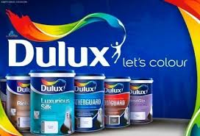
DULUX PAINTS
Complete interior range of low odour, low volatile organic compound(VOC) and green label-certified emulsion paints.

Slide 60
KEY PERSON
AkzoNobel
HEADQUARTERS
United Kingdom
MARKETS
World wide

Slide 61
VISION AND MISSION
We believe in the power to “Imagine a better Place”
We are inspired by the challenge of creating a better places and spaces

Slide 62
COLOR SOLUTIONS
offers over 2000 shades colour codes for Pure, Pearl Glo, Pentalite, EasyClean™, Supreme, Light & Space, Weathershield, Weathershield Max, Gloss Finish and Satinwood

Slide 63
MAJOR COMPETITORS
(DIRECT)
1.Berger paints
2.Master
3.Diamond
4.Marvell
5.Silky

Slide 64
INDIRECT
1.Tiles
2.Wood peeling
3.Wall papers
4.Rockwalls
5.Paint puree

Slide 65
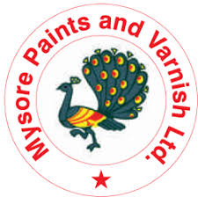
Mysore Paints
Founder – Maharaja Krishnaraja Wodeyar
Established – 1937
Owner- Government of Karnataka
Location-Mysore, Karnataka
Company owned by Govt. Of. Karnataka under the chairmanship of Mr.Anantha, Ex-Mayor Mysore City Cooperation.

Slide 66
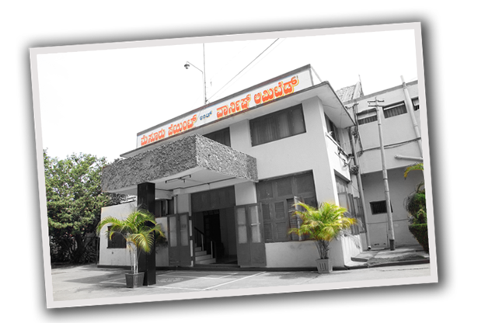
History

Slide 67
Mission
Preparation of INDELIBLE INK for elections

Slide 68
SHARE HOLDERS
Government of Karnataka – 91.39 percent
Remaining 1000 Share holders
Company listed on Bangalore stock exchange but its shares are not rated

Slide 69
Facts
Guards seal locks with wax produced.
Used in Pulse polio campaign
To mark cancer affected areas
Elections in India

Slide 70
Other products
Chemical-Resistant Paints,
Enamels,
Primers,
Distempers,
Sealing Wax,
Postage Stamp Cancellation, And Polishes

Slide 71
Revenue
Depends on Election
2006-2007, Profits 18Million
2004, Indian General Election 40Million
2008, 12.8 Million Cambodia elections

Slide 72
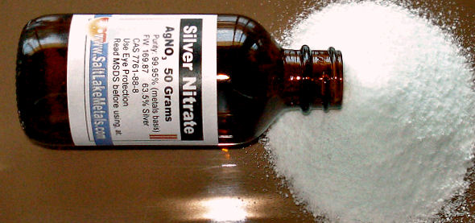
COMPOSITION OF VOTING INK

Slide 73
ADVANTAGES OF PAINTS
1.It prevents growth of fungus and bacteria on masonry surfaces.
2.Cement paint gives you good protection to all kinds of masonry surfaces from ultra violet rays present in sun rays.
3.It gives good protection from several climatic conditions like heat,water,humidity etc.

Slide 74
RANKING OF THE COMPANIES
1.Asian paint
2.Nippon paint
3.Indigo paint
4.Berger paint
5.Shalimar paint
6.Dulux paint
7.Kansai paints
8.Jotun paints

Slide 75
CONCLUSION
Over the next few years,the ratio of industrial paints to decorative paints expected to be 50:50,more in line with the global trend.currently it is 30:70
Decorative paint segment is expected to witness higher growth going forward.
The incentives given by the government to the housing sector have benefited the housing sector immensely. this will benefit key players in the long term.

Slide 76

BY,
RAVALIKA.P
PRIYA DHARSHINI.U
PRIYA DHARSHIN.B
KEERTHANA.M
DIVYA BARATHI
DIVYA.M

